Slide 3

ECG signal processing
Final exam presentation
Student: Do Tien Dat - 20200132

Slide 4
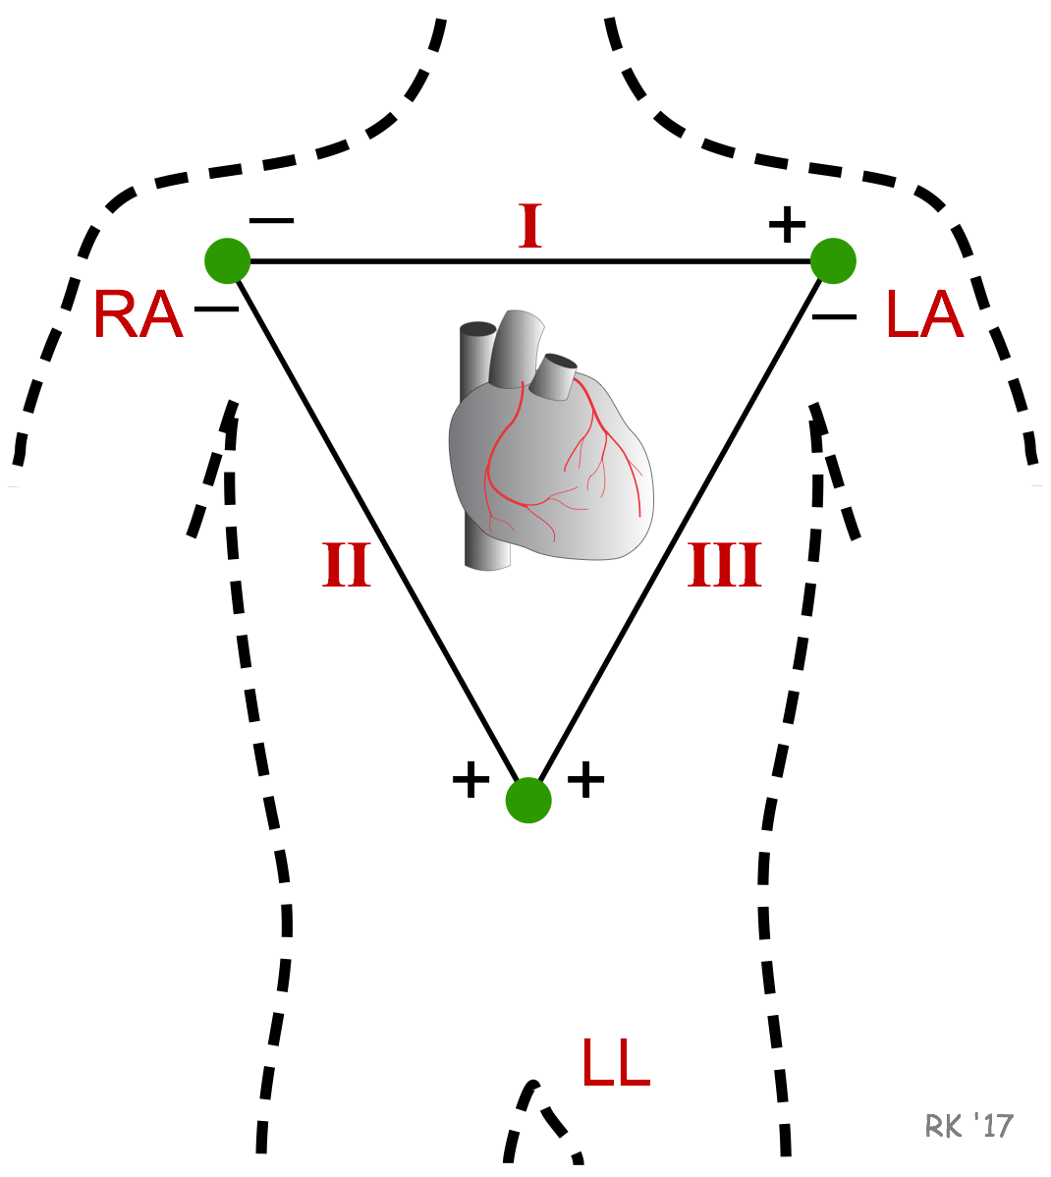
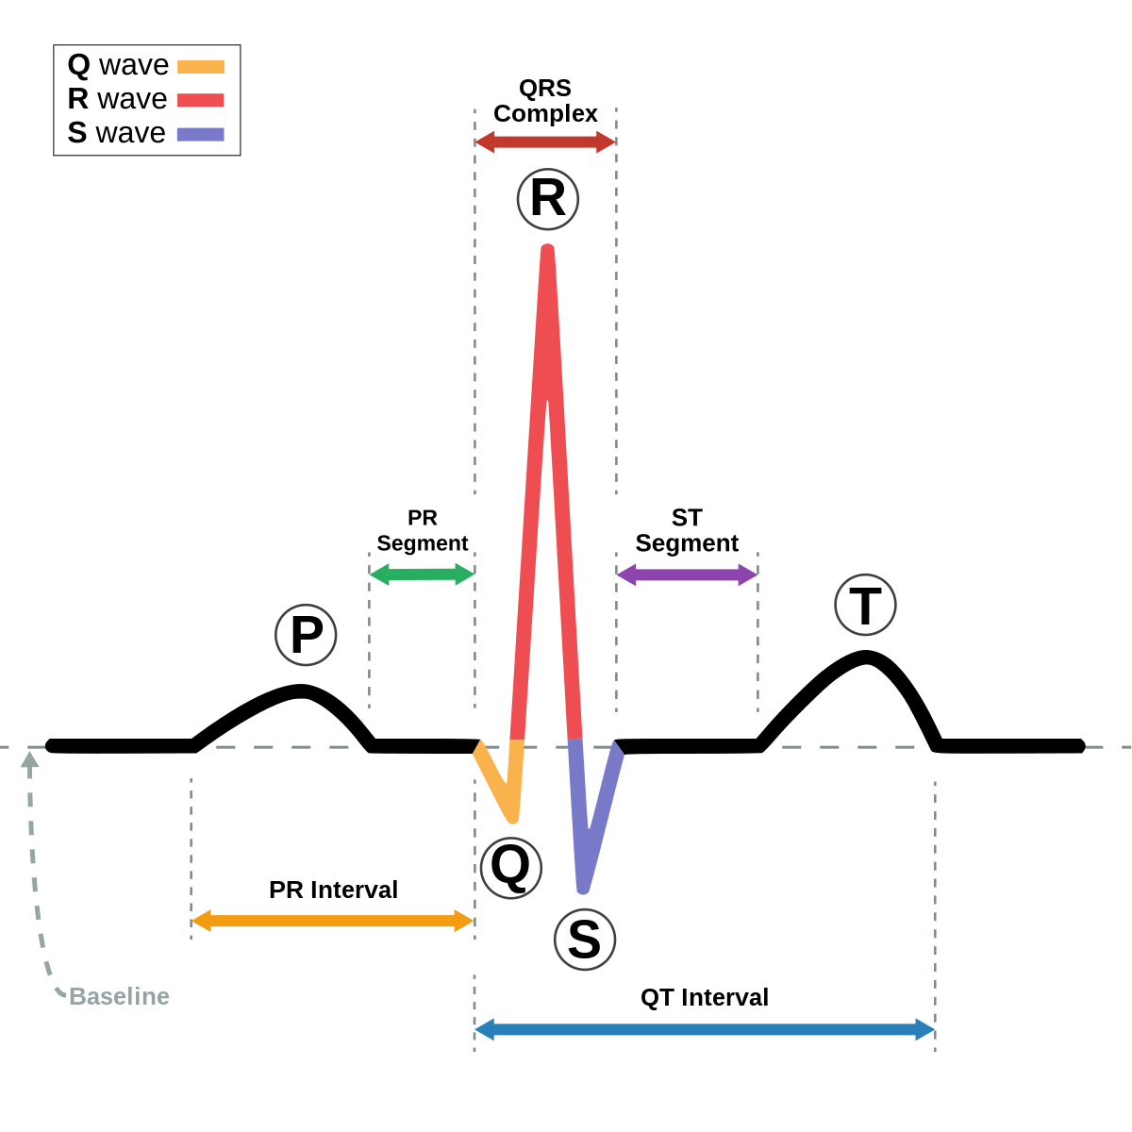

1. Data exploration:
Type of signal: ECG lead i
Patient:
Female, 81 yrs
Diagnose: Myocardial infarction
Data:
Sample rate: $1000Hz$
Record length: $38.4s$
Noise voltage: max $10μV_{pp}$
Input voltage: $±16mV$
Resolution: 16-bit with $0.5μV/LSB$
($2000A/D$ units per $mV$)
ADC range: $±16.384 mV (\sim 2^{14}/1000)$
Data source:
PTB Diagnosis ECG Database

Slide 5
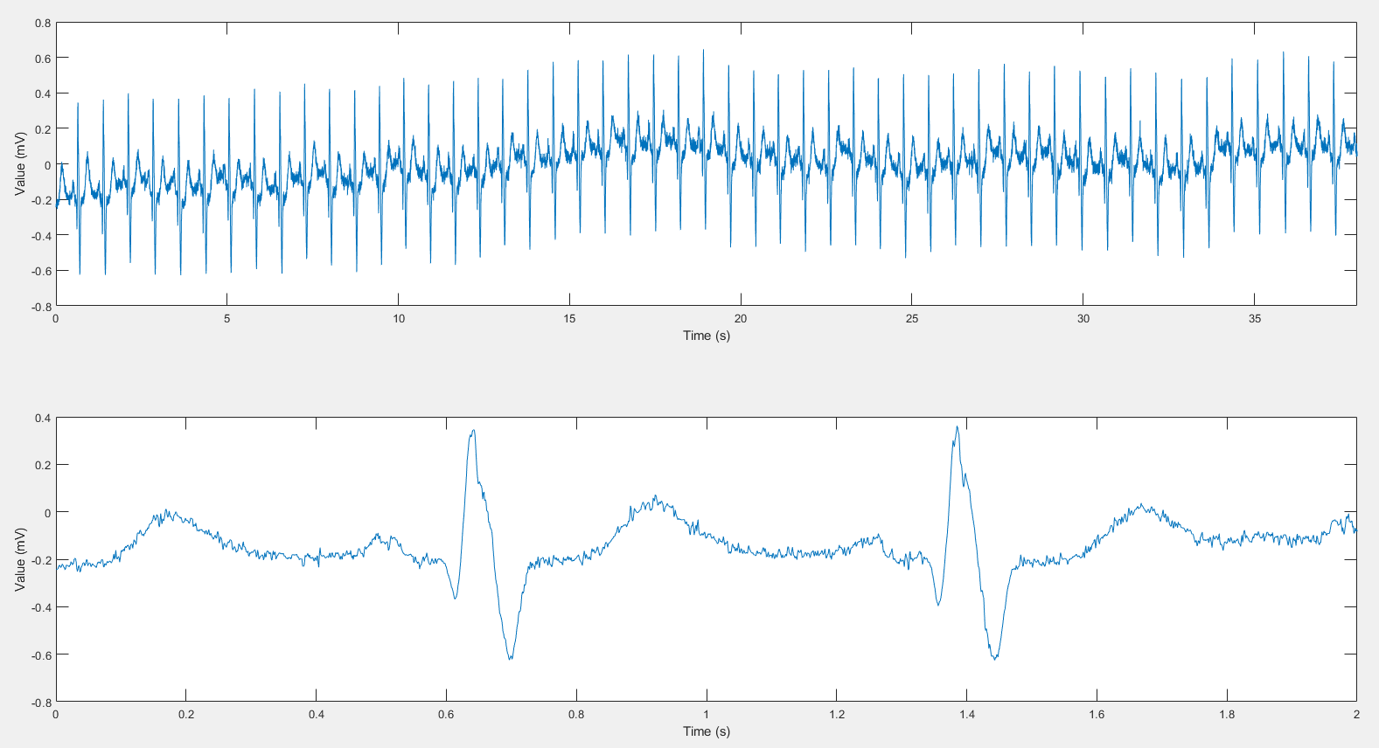
1. Data exploration:
ECG time-record

Slide 6
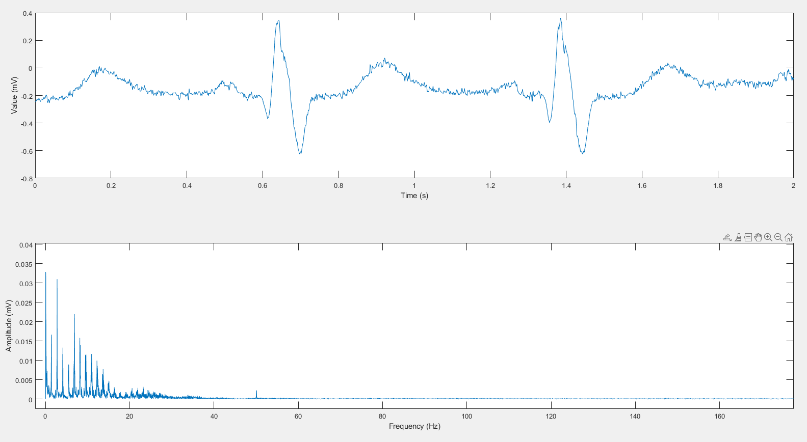
1. Data exploration:
Distorted P-wave
Base-line noise, maybe?
50Hz noise

Slide 7
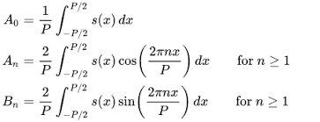
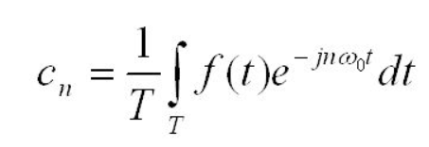
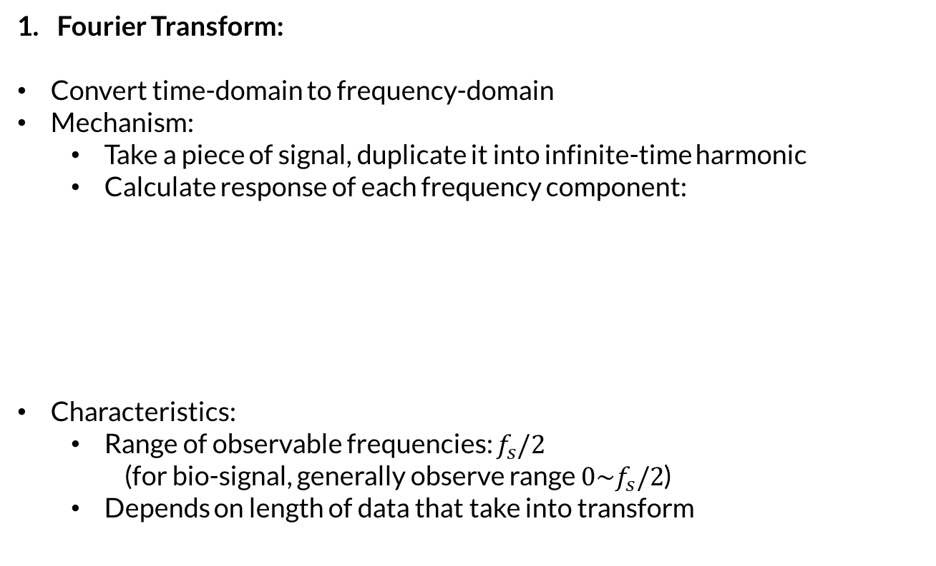
2. Processing methods:
Fourier Transform:
Convert time-domain to frequency-domain
Mechanism:
Take a piece of signal, duplicate it into infinite-time harmonic
Calculate response of each frequency component:
Characteristics:
Range of observable frequencies: $f_{s}/2$
(for bio-signal, generally observe range $0\sim f_{s}/2$)
Depends on length of data that take into transform
or
(complex number form)

Slide 8
2. Processing methods:
2. Window technique:
Mechanism:
Convolute time signal with a kernel (generally has a bell shape)
Characteristics:
Low-pass filter
Effect:
Remove high frequency components
Smoothing
Reduce sample size

Slide 9
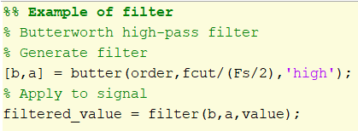
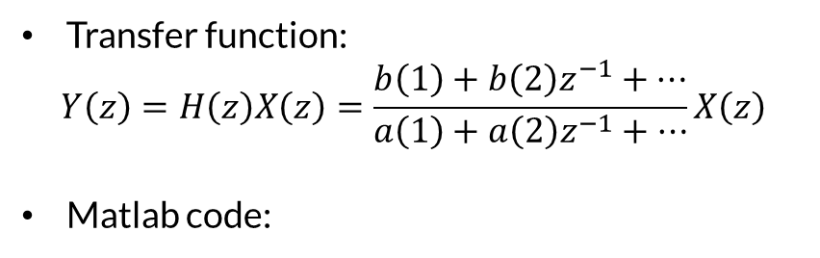
2. Processing methods:
3. Filtering:
Mechanism:
Observe signal in a specific frequency range
Filter out components that is considered as ‘noise’
Types of filter:
Low pass
High pass
Notch
Bandpass
Several filters:
Butterworth
Windowed
Transfer function:
$$Y\left(z\right)=H\left(z\right)X\left(z\right)=\frac{b\left(1\right)+b\left(2\right)z^{−1}+…}{a\left(1\right)+a\left(2\right)z^{−1}+…}X\left(z\right)$$
Matlab code:

Slide 10
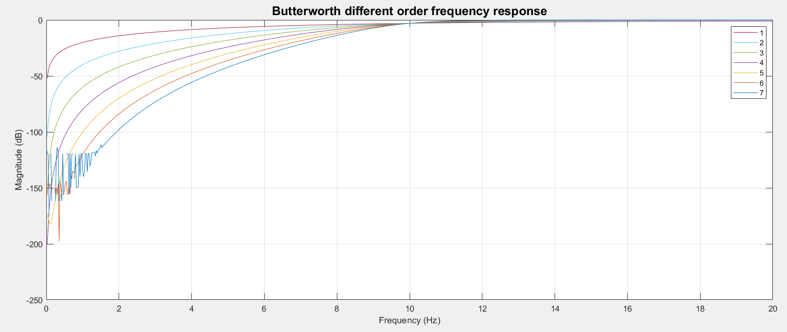
2. Processing methods:
3. Filtering:
Butterworth filter order:
-3dB
Best order (n=4)
Unwanted ripple

Slide 11
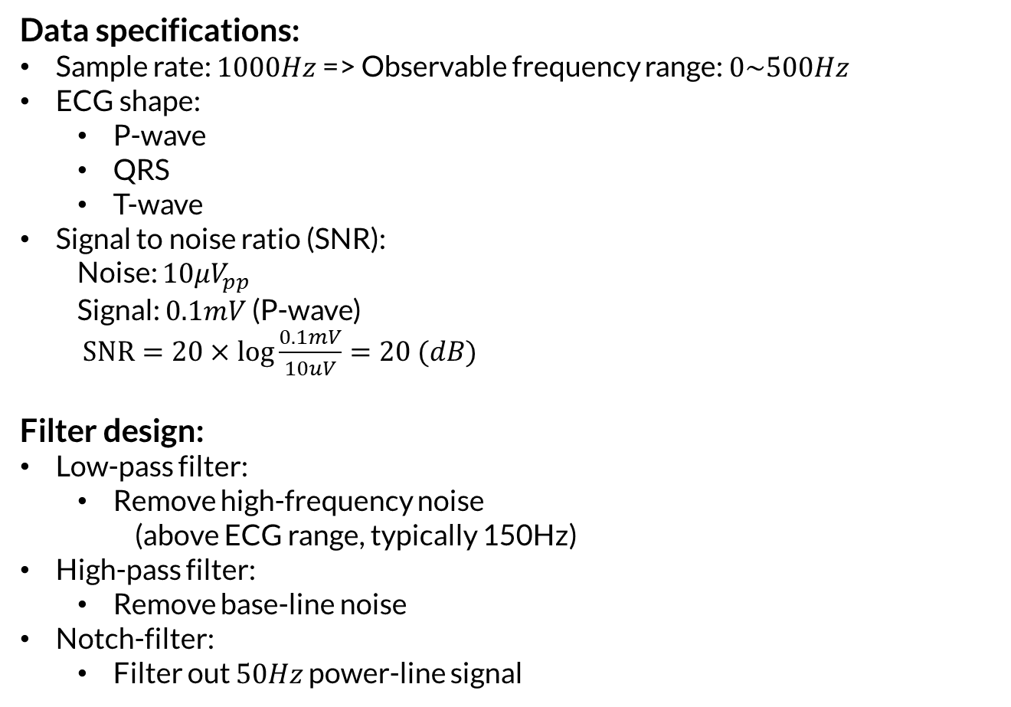
3. Data interpretation:
Data specifications:
Sample rate: $1000Hz$ => Observable frequency range: $0\sim 500Hz$
ECG shape:
P-wave
QRS
T-wave
Signal to noise ratio (SNR):
Noise: $10μV_{pp}$
Signal: $0.1mV$ (P-wave)
$SNR=20×log{\frac{0.1mV}{10uV}}=20 (dB)$
Filter design:
Low-pass filter:
Remove high-frequency noise
(above ECG range, typically 150Hz)
High-pass filter:
Remove base-line noise
Notch-filter:
Filter out $50Hz$ power-line signal

Slide 12
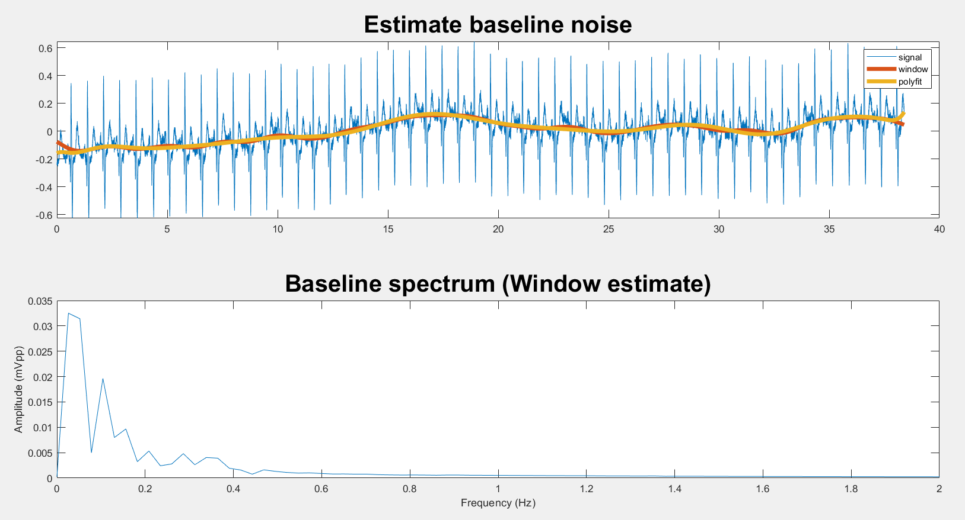
3. 1. Base-line noise:
Use Window function to estimate base-line noise
Determine and calculate specs for high-pass filter to remove base-line noise

Slide 13
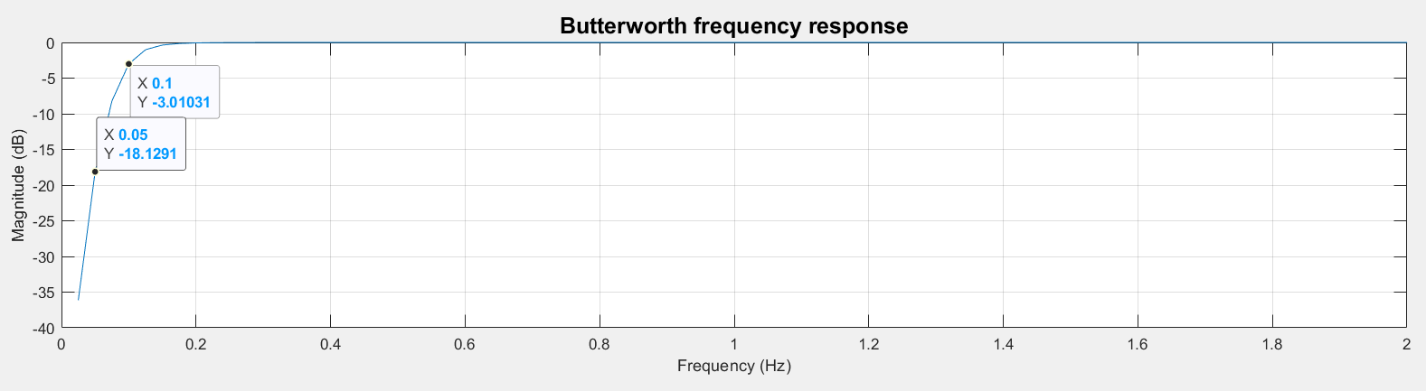
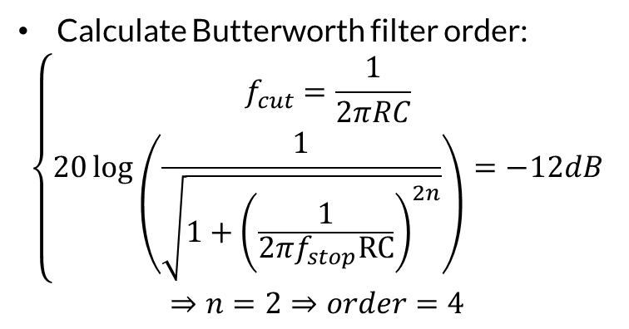
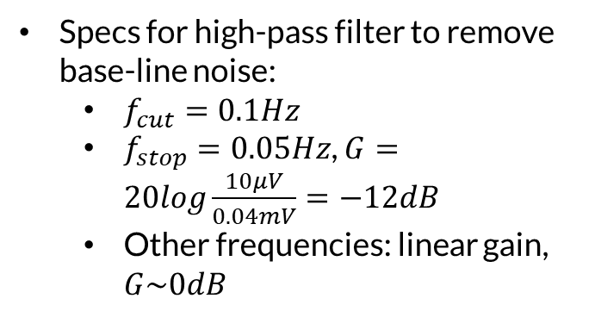
3. 1. Base-line noise:
Specs for high-pass filter to remove base-line noise:
$f_{cut}=0.1Hz$
$f_{stop}=0.05Hz$, $G=20log\frac{10μV}{0.04mV}=−12dB$
Other frequencies: linear gain, $G\sim 0dB$
Calculate Butterworth filter order:
$$\left\{\begin{aligned}f_{cut}=\frac{1}{2πRC} \\ 20\log\left(\frac{1}{\sqrt{1+{\left(\frac{1}{2πf_{stop}RC}\right)}^{2n}}}\right)=−12dB\end{aligned}\right.$$
$$⇒n=2⇒order=4$$
High pass filter for baseline response

Slide 14
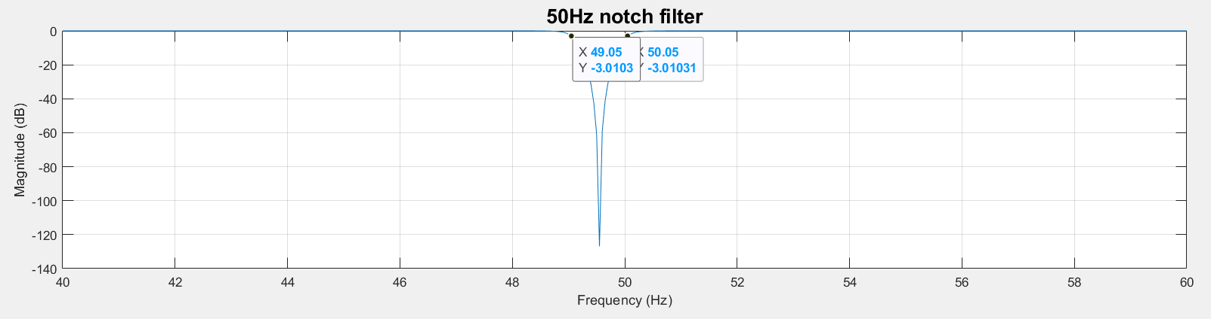
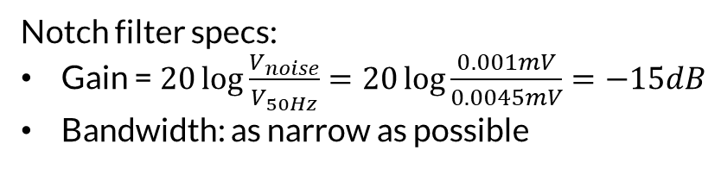
3.2. 50Hz power line noise:
Notch filter specs:
Gain = $20\log{\frac{V_{noise}}{V_{50Hz}}=20\log{\frac{0.001mV}{0.0045mV}=−15dB}}$
Bandwidth: as narrow as possible
-120dB, not bad
50Hz notch filter response

Slide 15
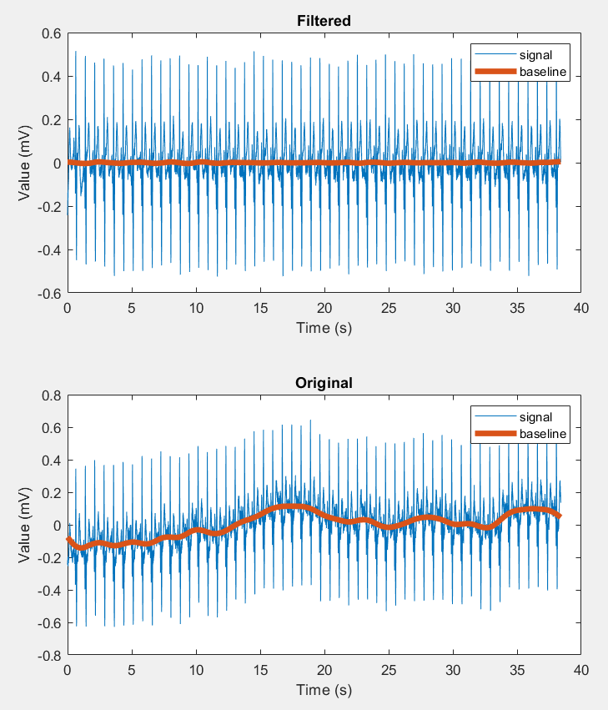
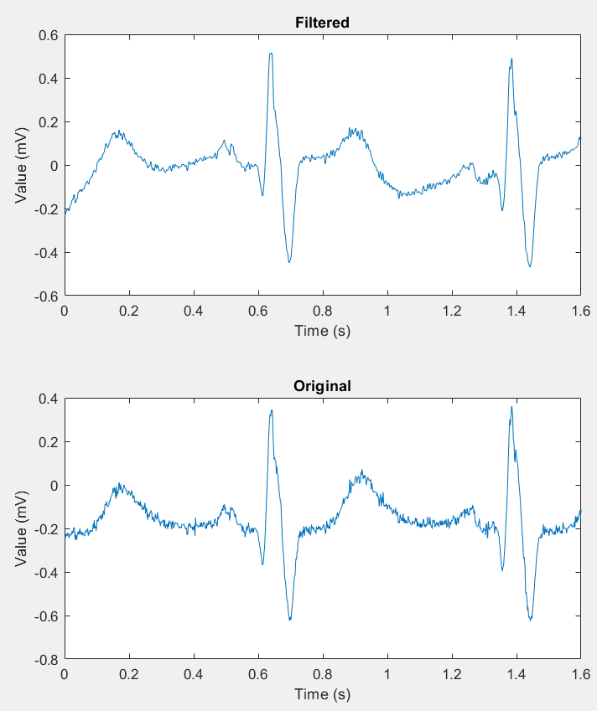
4. Filtering results:
Filtered vs Original signal

Slide 16
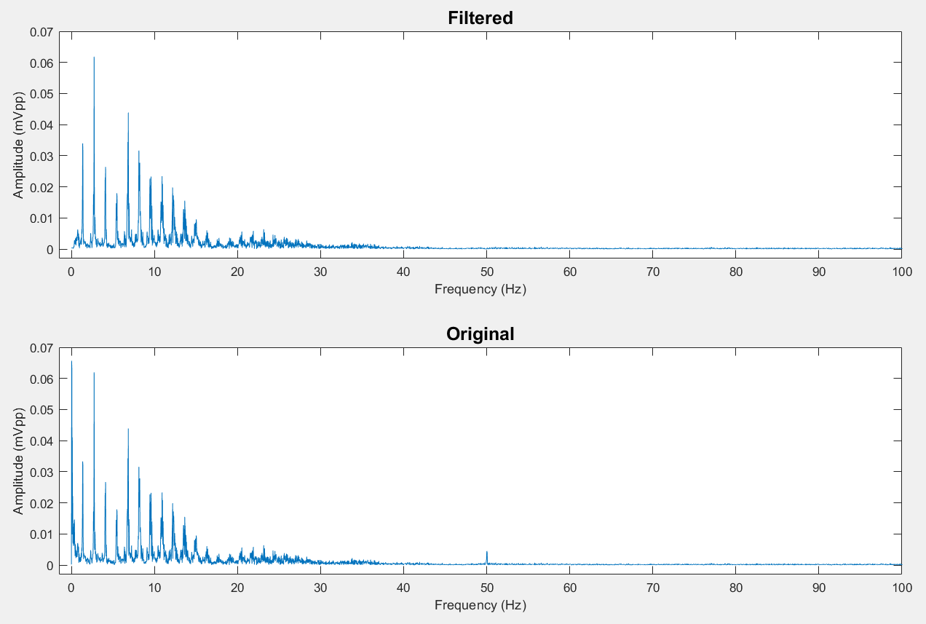
4. Filtering results:
Filtered vs Original spectrum

Slide 17
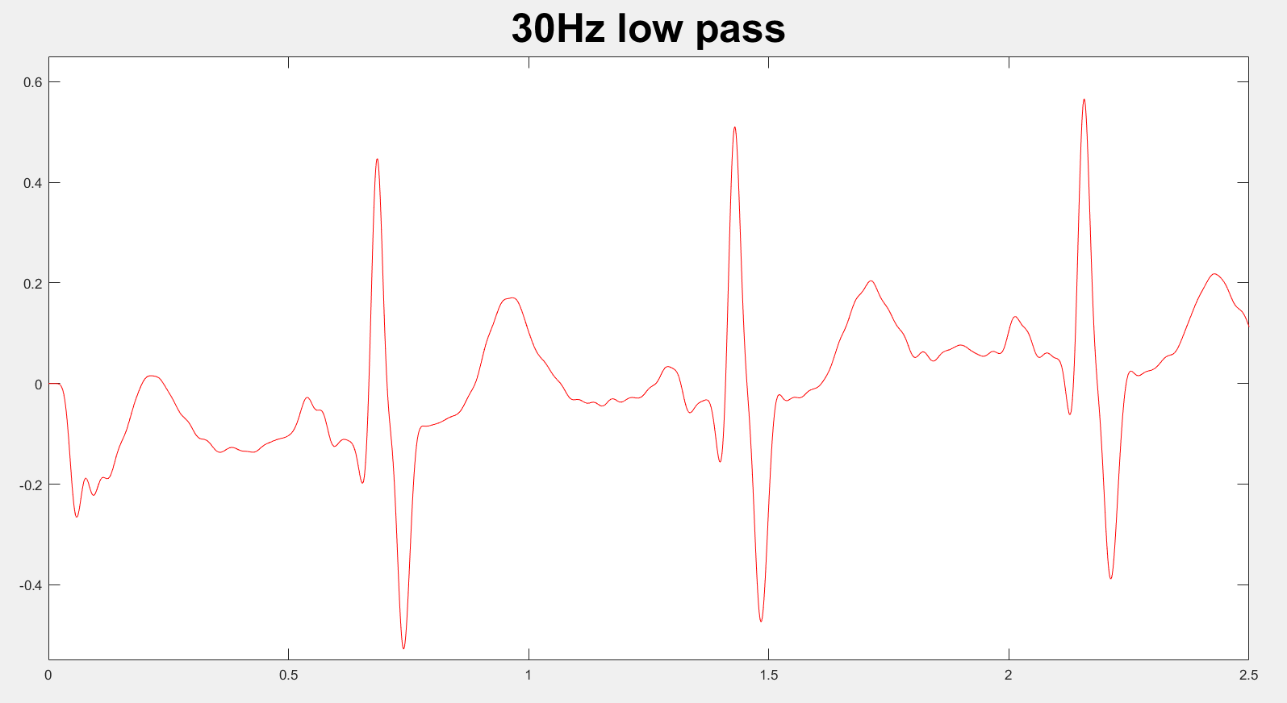

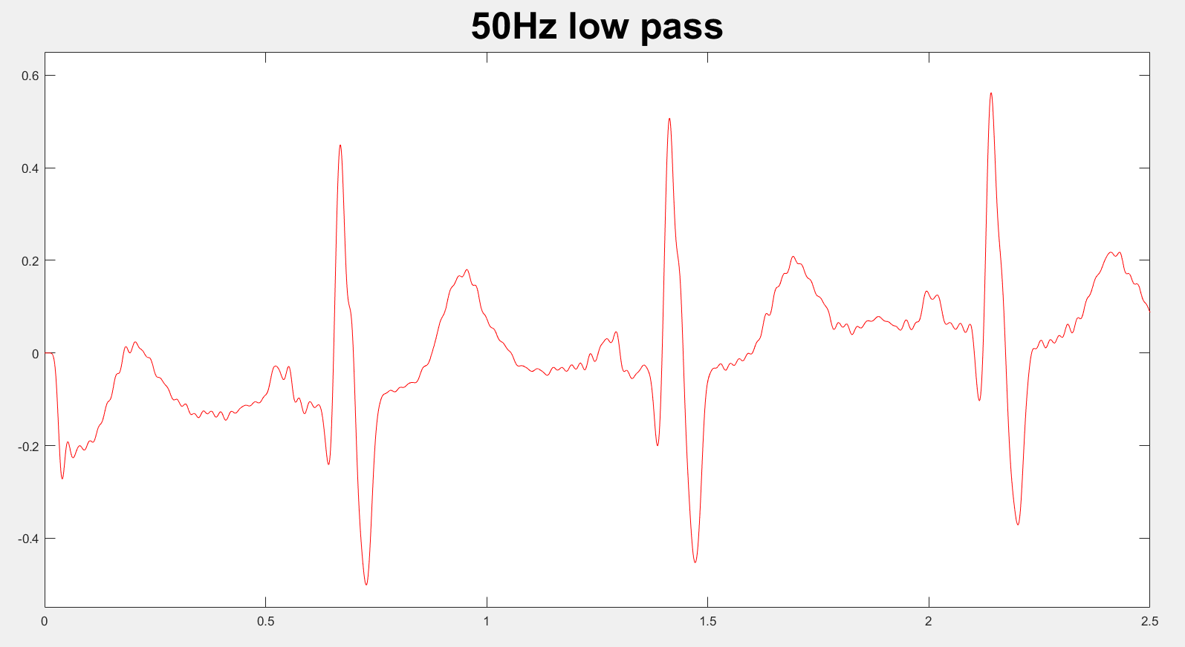
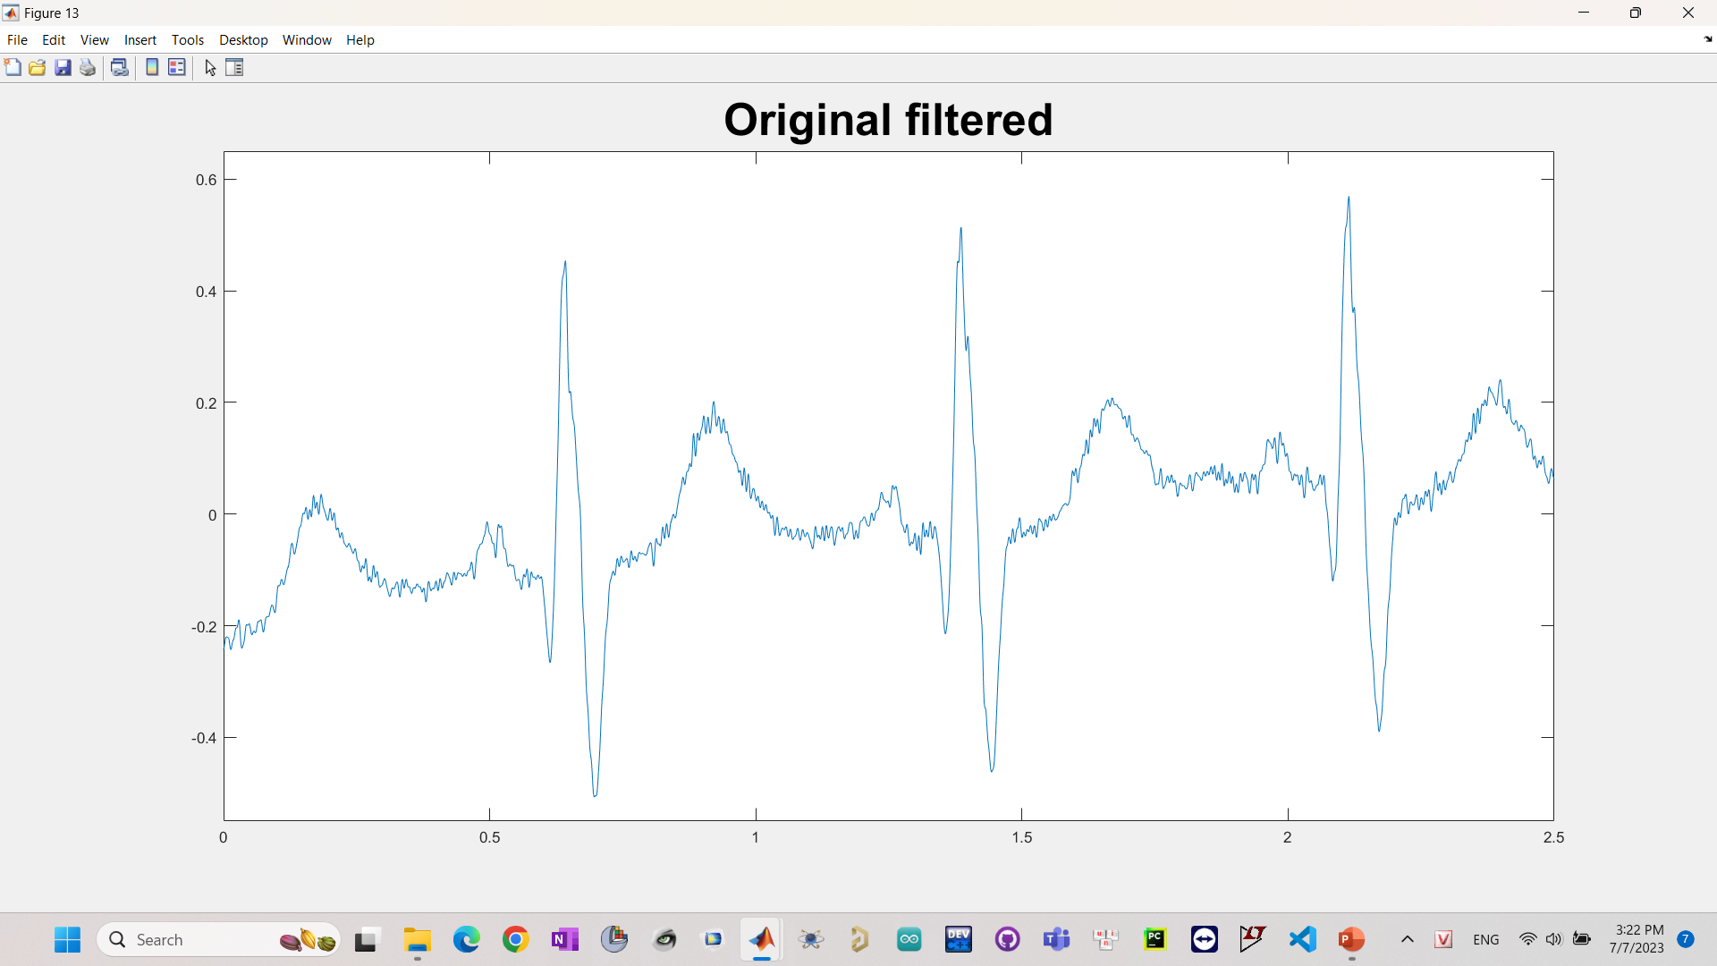
4. Filtering results:
Lost information
P-wave distortion
Different bandwidth range

Slide 18
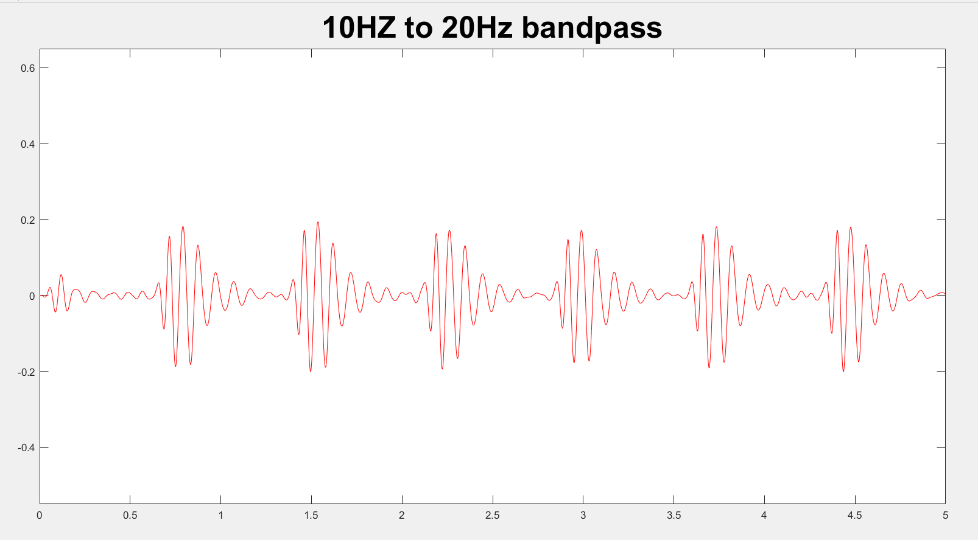
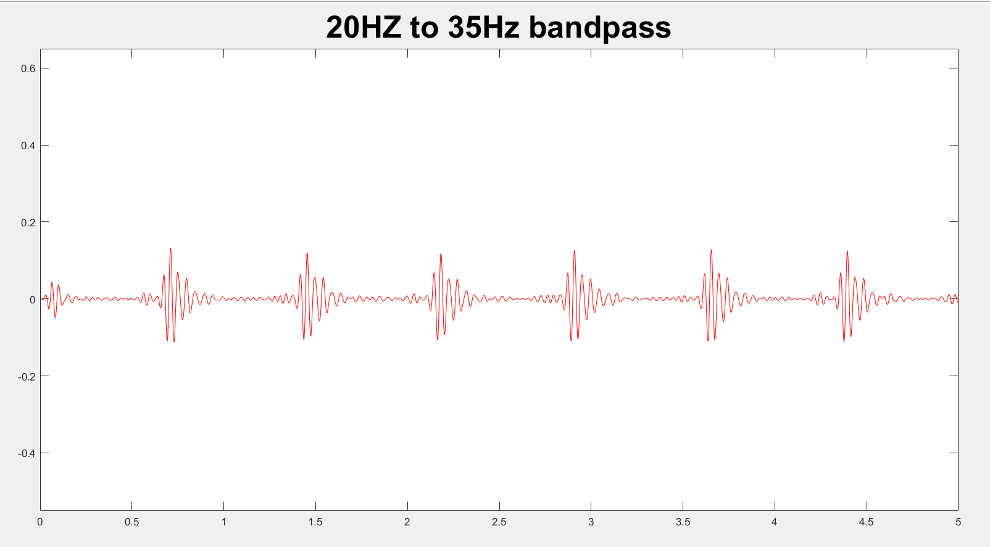
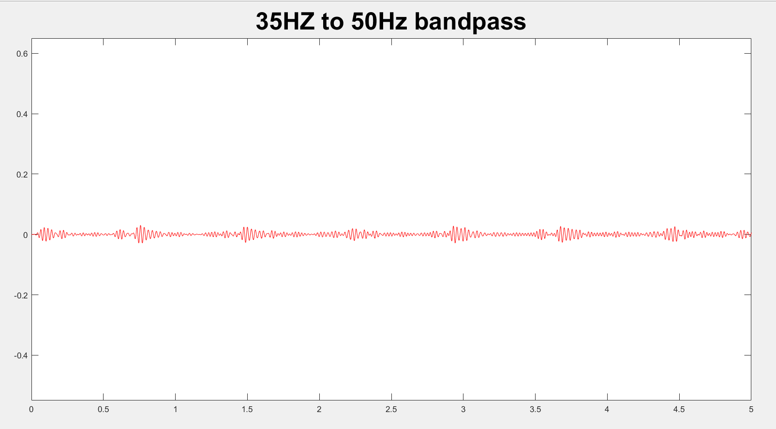
4. Filtering results:
Different bandwidth range

Slide 23
THANK YOU !

